Slide 1


SAP S/4HANA CDS, RAP Training Day 8
Anubhav Oberoy

Slide 2

Agenda – Day 8
Local Types/Classes in ABAP with Global Classes
Implementing Class Pool Concept
--break
Behavior Definition Introduction
Create Behavior Definition
Create Behavior implementation for Unmanaged Scenario
Sequence Diagram
Implementing Create, Update and Delete
Make field read only
Making field Mandatory
Add validation to the code
Implement Actions - set_status_booked
--break
What is EML ?
Why we use EML
Syntax of EML
C-R-U-D Using EML
Implementation of EML
Notes:
https://unsplash.com/photos/CPs2X8JYmS8

Slide 3

Developing Read only List Report
UI Annotations
@UI.selectionField – Bring a filter field on smart filter bar
@UI.lineItem – enable us to put a column inside the smart table, position, label
@UI.identification – used create fields in Object page
@Semantics.amount.currencyCode – mark the unit of amount field
@UI.headerInfo.typeName – Label for displaying single record
@UI.headerInfo.typeNamePlural – Table Label
@UI.facet: [{purpose : #STANDARD – This will create a section inside the object page
type: #IDENTIFICTION_REFERENCE – What type of data you want to display}]
Documentation
Documentation Link for ABAP RAP

Slide 4

Local Types/Classes in ABAP with Global Classes
Local Types for Global Classes - Within class pools, as in virtually any other ABAP program, data types, local interfaces, and local classes can be defined to ensure a better structure of the implementation of the global class.
More number of classes will cause confusion and over-modularization increase the complexity of our design
More number of global classes, will increase the chance of our code being exposed to reports/classes which we may want to use only a private
Allow a modularized way of designing app but still keeping our code in a single contain, a good balance between number of classes v.s modularization.
At times we need so many classes for different purpose with very limited no of methods. 2 meh. + 20 classes, Create a class pool would be a good options.

Slide 5
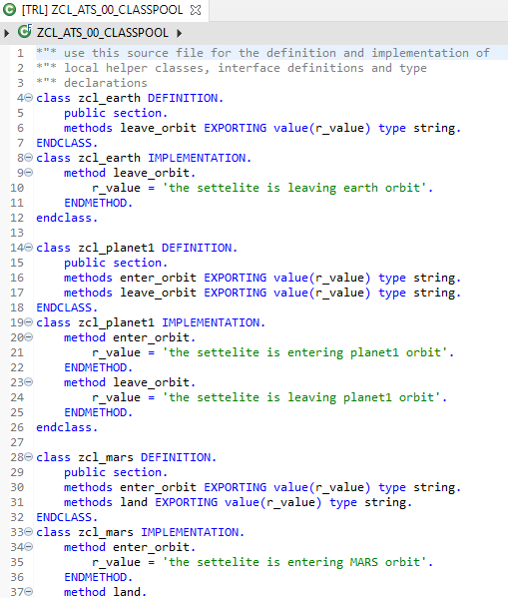
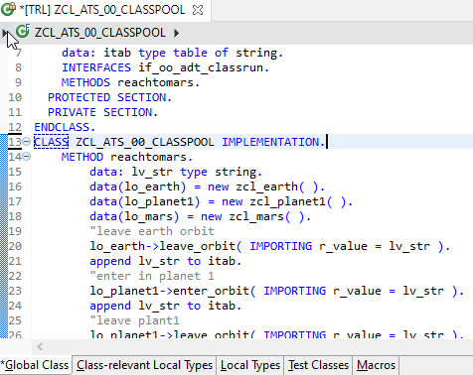
Implementing Class Pool Concept
Global Class
Local Types/Class

Slide 6































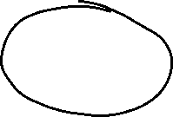

Slide 7
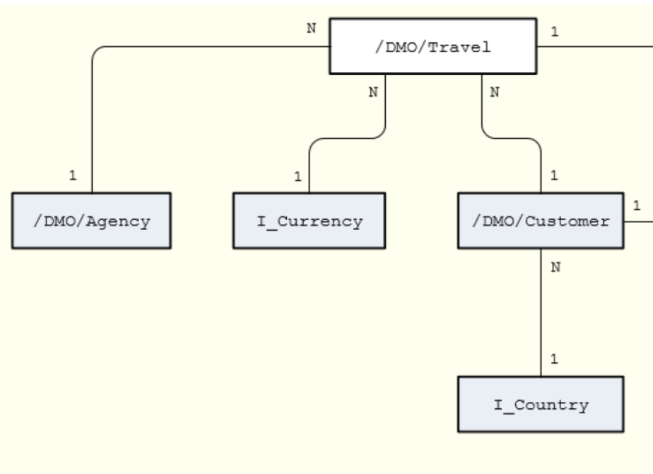
Un-managed Implementation
The scenario described below focuses on an unmanaged implementation type of a business object provider in the context of the ABAP RESTful programming model.
For the unmanaged implementation type, the application developer must implement essential components of the REST contract itself. In this case, all required operations (create, update, delete, or any application-specific actions) must be specified in the corresponding behavior definition before they are manually implemented in ABAP.
The figure below shows the relationships between the travel, agency and customer entities where the travel entity represents the root of the data model. Additional entities for currencies (I_Currency) and countries (I_Country) are generally available in your system and are included in our data model using associations.

Slide 8
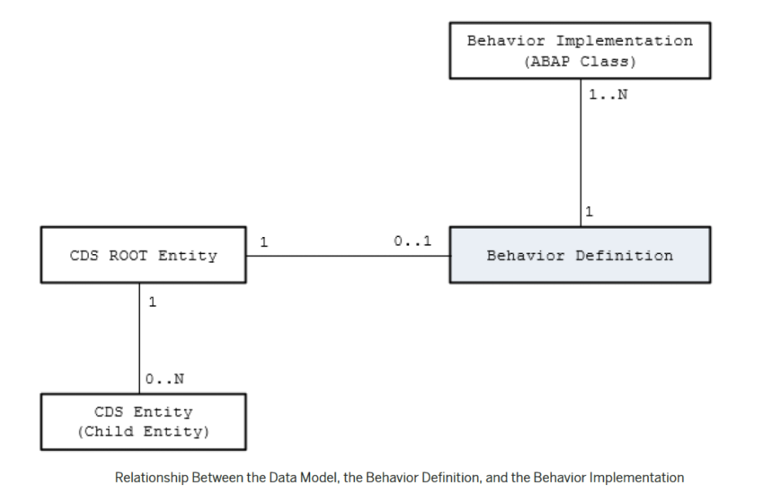

Behavior Definition
A business object behavior definition (behavior definition for short) is an ABAP Repository object that describes the behavior of a business object in the context of the ABAP RESTful programming model.
A behavior definition is defined using the Behavior Definition Language (BDL) and comprises capabilities and modelling aspects of the business object node or nodes, for example the supported operations (such as create, update, and delete actions) or the definition of lock dependencies between the parent and child nodes.
A behavior definition always refers to a CDS data model. This reference results from the name equality with the root entity. This means that a CDS data model must always exist before the behavior definition is created.
A behavior definition relies directly on the CDS root entity.
One behavior definition refers exactly to one root entity and one CDS root entity has a maximum of one behavior definition (a 0..1 relationship), which also handles all associated (child) entities.
The implementation of a behavior definition can be done in a single ABAP class (behavior pool) or can be split between an arbitrary set of ABAP classes (behavior pools). You can assign any number of behavior pools to a behavior definition (a 1: n relationship).

Slide 9
Behavior Pool
The transactional behavior of a business object in the context of the current programming model is implemented in a global ABAP class or classes. These special classes are dedicated only to implementing the business object’s behavior and are called behavior pools.
the implementation of a behavior definition can be done in one class or split across an arbitrary set of ABAP classes.
You can assign any number of behavior classes to a behavior definition (a 1: n relationship). Within a single global class, you can define multiple local classes that handle the business object’s behavior.
The global class is just a container and is basically empty while the actual behavior logic is implemented in local classes.
Local class 1 for Entities
Behavior Definition
Class Pool
Local class 2 for Entities
Local class 3 for Entities

Slide 10
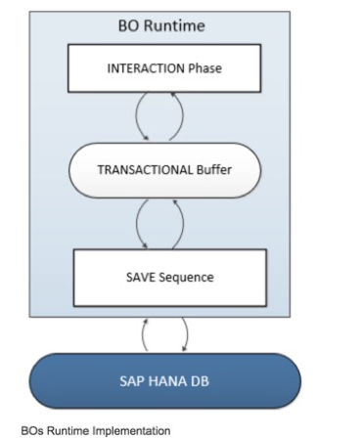
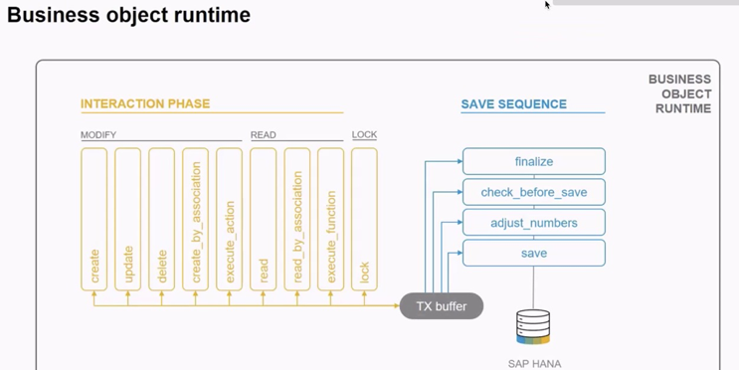
Business Object’s Runtime Implementation
The business object runtime mainly consists of two parts: The first part is the interaction phase where a consumer calls the business object operations to change data and read instances with or without the transactional changes. The business object runtime keeps the changes in its internal transactional buffer which represents the state of the instance data. This transactional buffer is always required for a business object. After all changes were performed, the data can be persisted. This is realized with the save sequence.

Slide 11





























Slide 12






















Slide 13
What is %CID
%CID stands for the content ID and is used in an OData request to bind the result of an operation to a name so that it can be referenced in another operation later in the transactional processing.
In some use cases, it may happen that a consumer works with data that is not yet persisted and might not have a primary key yet. The primary key can be created in the <method> FOR MODIFY call or later in the save sequence (late numbering). In such cases, a temporary primary key, the content ID (%CID) for an instance, is used as long as no primary key was created by BO runtime. The content ID is consequently also used then as a foreign key.

Slide 14
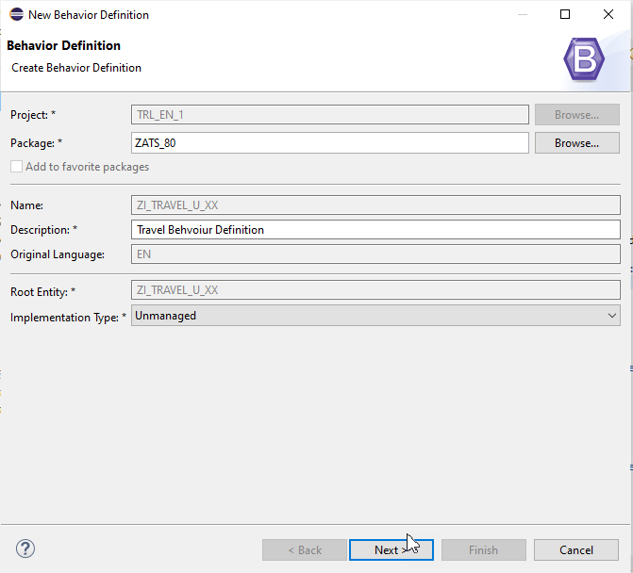
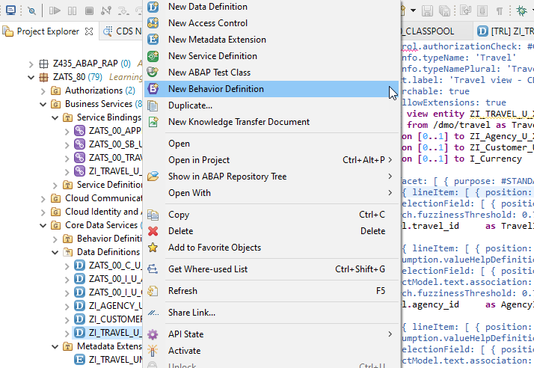
Create of Behavior Definition

Slide 15
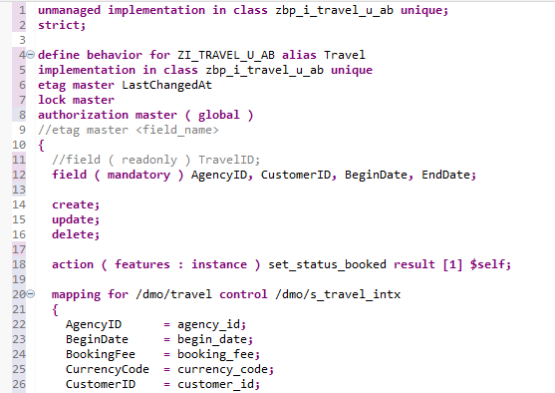
Implementing Behavior Definition

Slide 16
Fiori App
OData
RAP
B-IMP
Legacy Code
post
Agency customer id
Start date
End date
Create
Create IMPORT
Entities (%cid)
Write to TB
messages
save
Save to DB
cleanup

Slide 17

































Slide 18
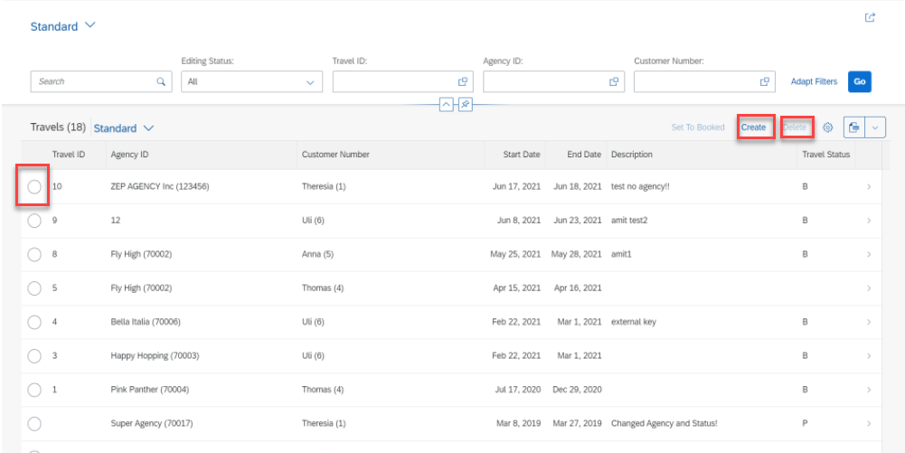
Implementing Create, Update and Delete
For the Functionality of Create ,Update & Delete we Implement the Code in Behavior Definition Class.
Step 1: Click Create Button.

Slide 19
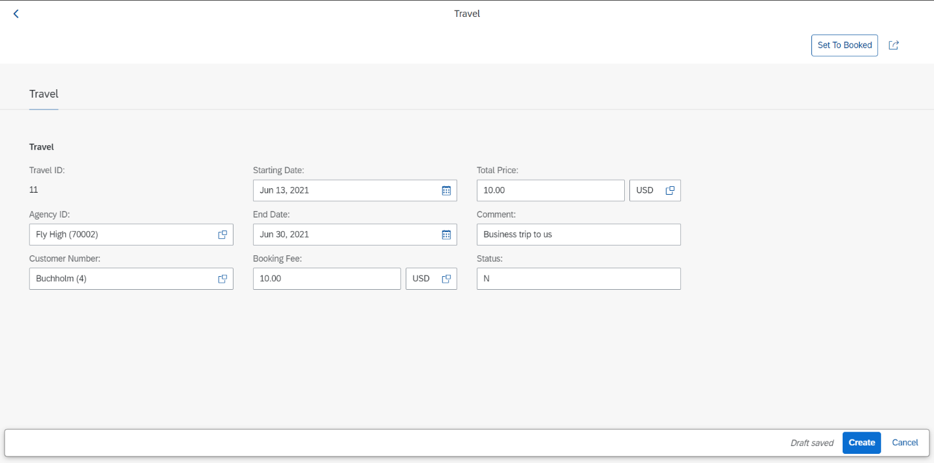
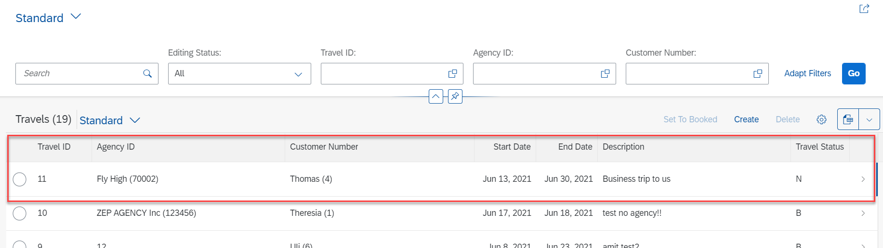
Implementing Create
Step 2: Fill all Correct Entries and Click on Create Button.

Slide 20
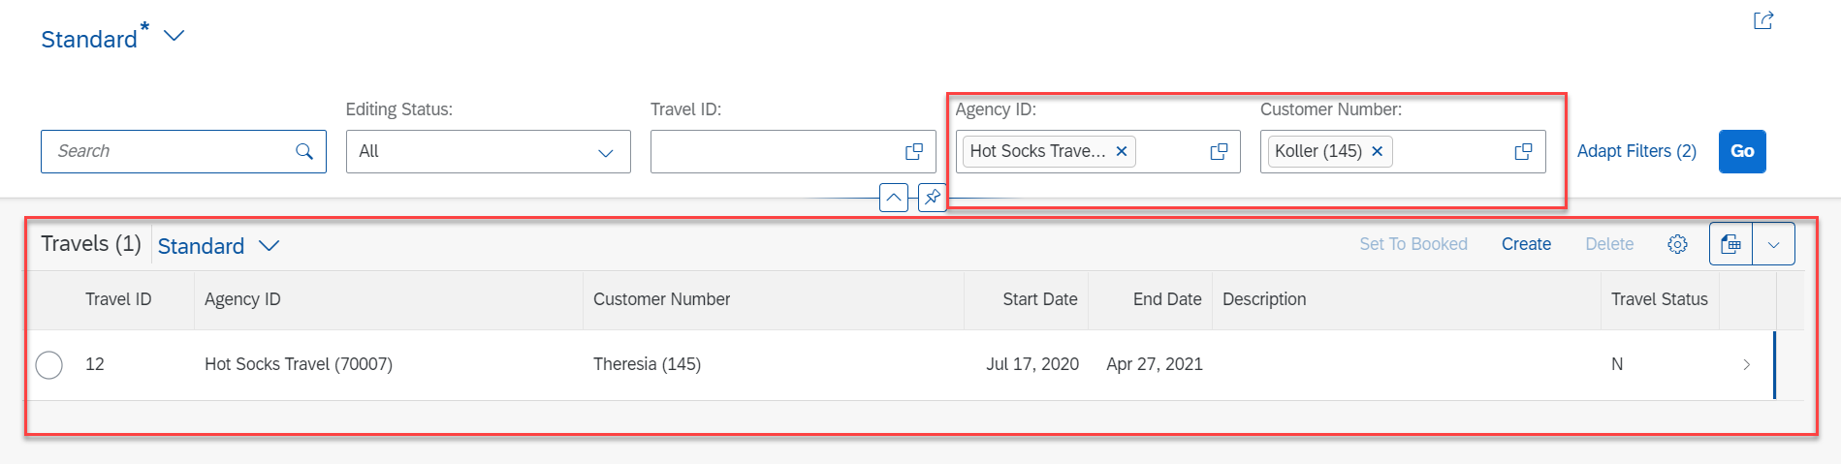
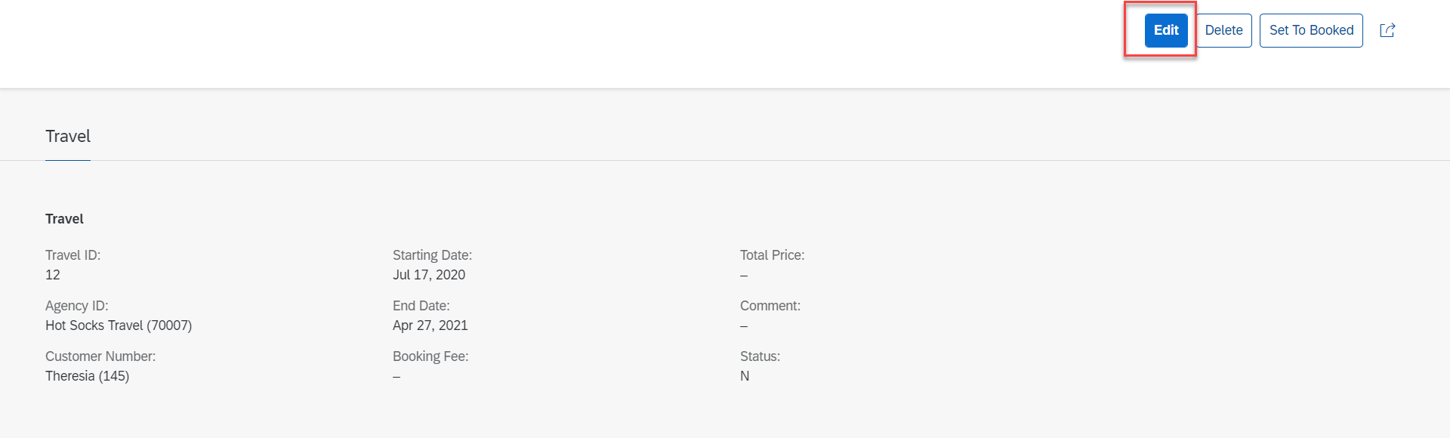
Implementing Update
Step 3: Select a Radio Button and Click Edit Option for Update.

Slide 21
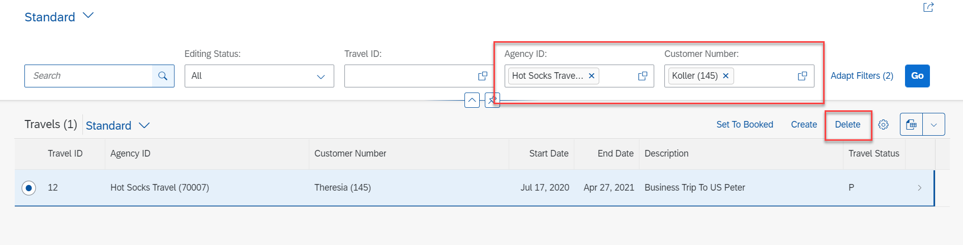
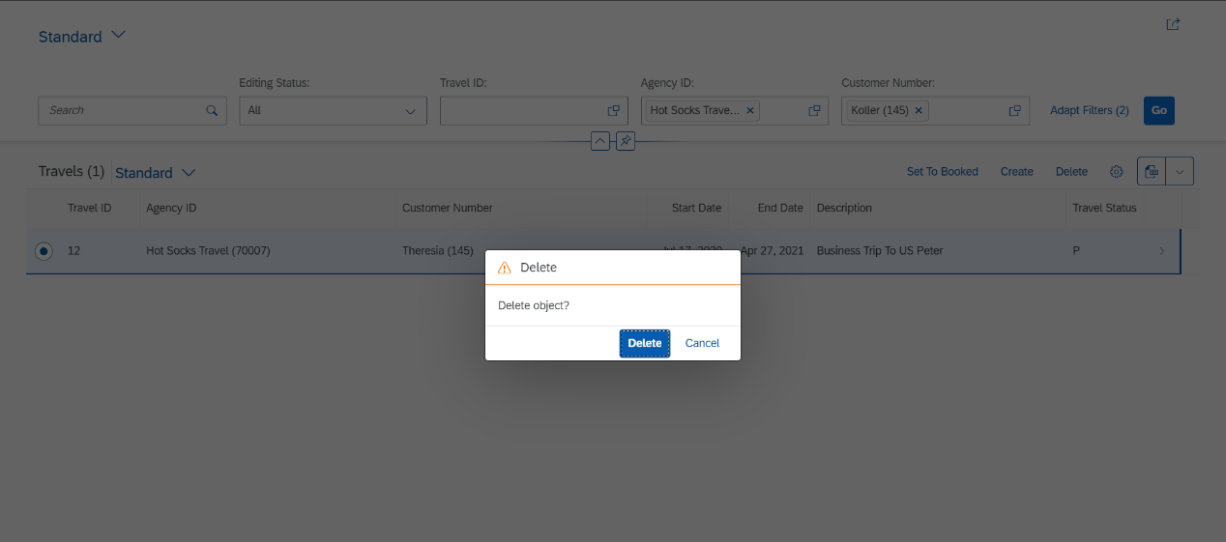
Implementing Delete
Step 4: Select a Radio Button and Click on Delete Button.

Slide 22
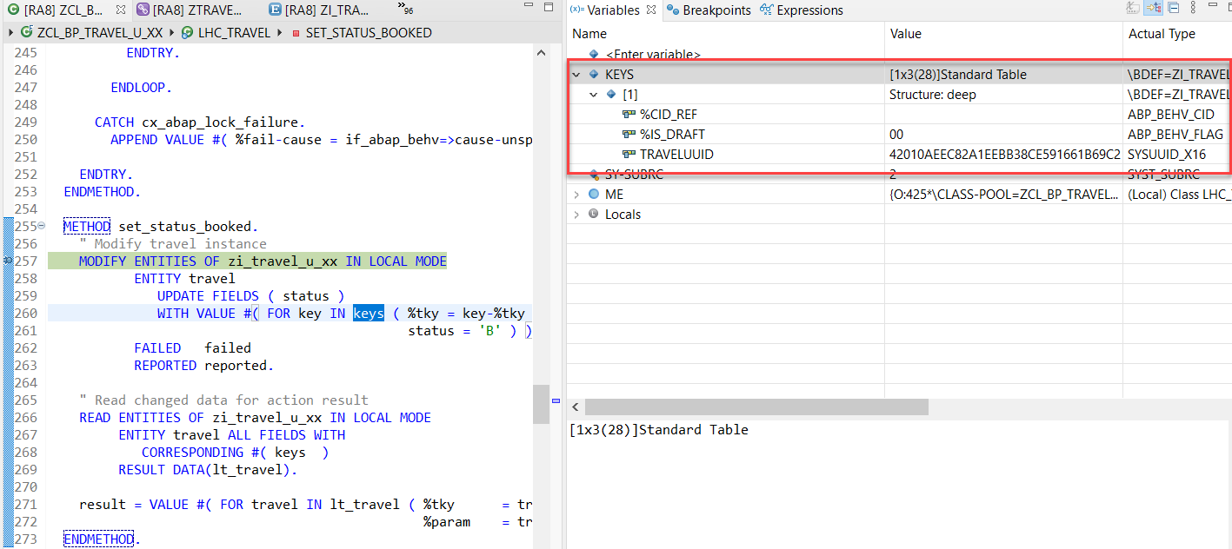
Action Implementation
“Actions” are addition operations in addition to CRUD operations. Are the operations which are non-standard for a business object
Below steps describes the implementation of an action related to the travel instances. Using this action, the end user should be able to change the status of travel processing.
Adding a Type Definition for Import and Export Parameters Required for the Action SET_STATUS_BOOKED
Implementing the Action Handling.

Slide 23
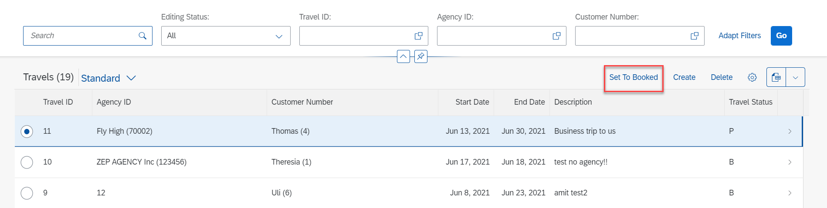
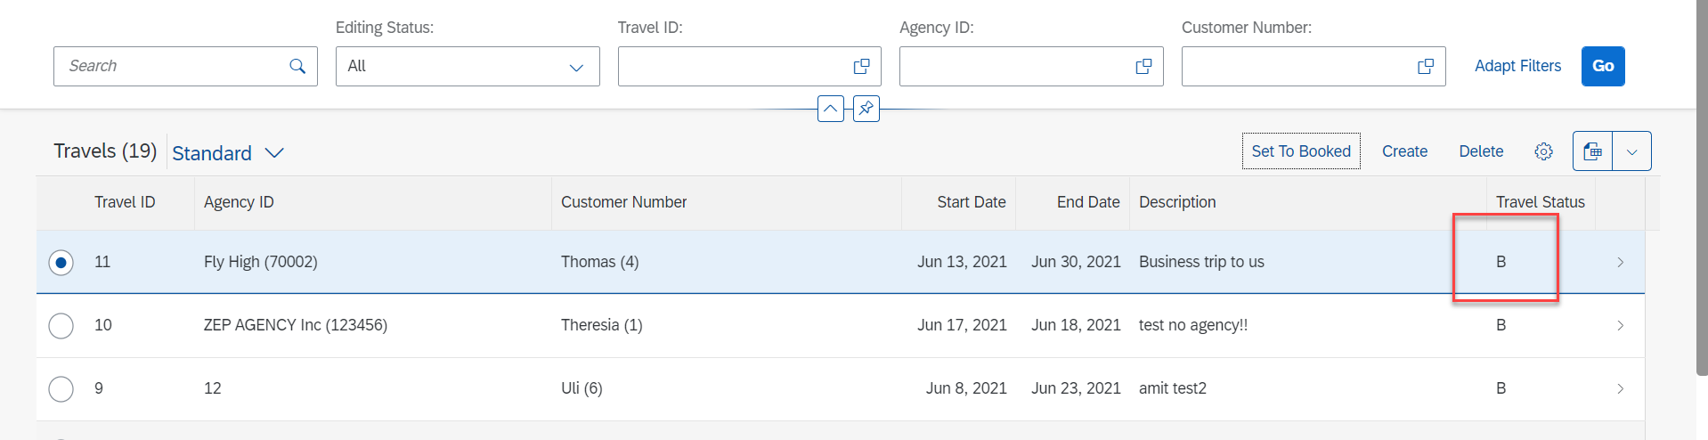
Action Implementation
Select Radio Button and Click on Set To Booked & Travel Status Change to Book (B)

Slide 24
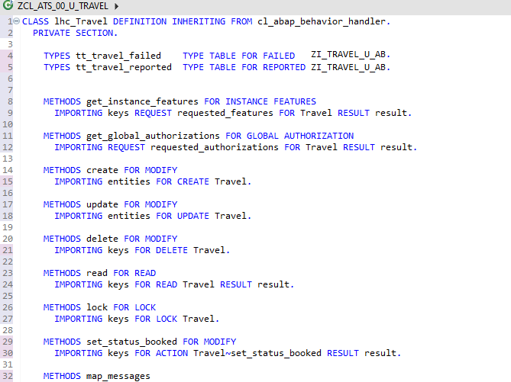
Behavior Pool Logic
Exercise
Behavior Pool Logic

Slide 25
What is EML ?
The Entity Manipulation Language (EML) is a part of the ABAP language that enables access to RAP business objects. Because the consumption of business objects via the OData protocol requires a Fiori UI or a web API, EML enables a type-safe access to business objects directly by using ABAP.
A Business Object in RESTful ABAP is consists of multiple Entities. This is a entity composition tree with one entity acting as a root. EML is part of the ABAP language and used in context of RESTful ABAP to control the BO behavior (create, read, update, delete).
We can use the EML in ABAP to test our BO. We can call the BO using EMP from ABAP program in 2 ways
01
Standard (Statically)
Generically (Dynamic) framework.
02

Slide 26
Syntax of EML
The EML provides us 3 important access statements for Data Manipulation using BO( Business Object ).
01
Perform the CUD ( Create ,Update ,Delete on BO
MODIFY ENTITIES OF RootEntityName
ENTITY EntityAliasName
[ CREATE FROM it_instance_c ]
[ UPDATE FROM it_instance_u ]
[ DELETE FROM it_instance_d ]
[ CREATE BY \AssociationName FROM it_instance_cba ]
[ RESULT et_result_tab ] [ FAILED failed ] [ REPORTED response ] [ MAPPED mapped ]
02
Commit Entities
Will actually persist the changes in the DB from transaction buffer. Any modify operation that are executed within behavior pool or by ABAP program are not causing any DB change because they are applied on transaction Buffer and this buffer content will disappear when ABAP session ends. So if we want the changes to be passed to SAVE SEQUENCE and persisted, we will use the COMMIT ENTITIES statement.
finalize ( )
check_before_save( )
Adjust_numbers( )
Save( )

Slide 27
Syntax of EML
03
Read the Data
All operations that do not need to change the data of an entity are carried out by READ Data.
There 2 types of Read
Read Entity by Key
Read Access to child (association) by parent key
Read Statement always returns the RESULT and you must specify target variable. We can also read the associated entity data using BY \asso_name FROM it_table syntax.
The result of associated data with come in another internal table LINK tab_name, it will always contain the key value pair.
READ ENTITIES OF RootEntityName
ENTITY EntityAlias FROM it_read_condition
RESULT et_result
BY \asso_name FROM it_read_rba
RESULT et_res_rba
LINK et_link_keys
ENTITY EntityAlias FROM it_ins_2…. [ FAILED failed ] [REPORTED reported]

Slide 28

Rule for EML
In addition to the data we also have a compiler generated field in input and output results called %control, this field is responsible to inform the RESTful framework that, which are all the fields we would like to send to DB while creation or update while updating. Also while read we can specify the same to avoid reading everything.
We can also see the complete BO structure in BO Explorer using keyboard shortcut :-
Alt+Shift+W

Slide 29
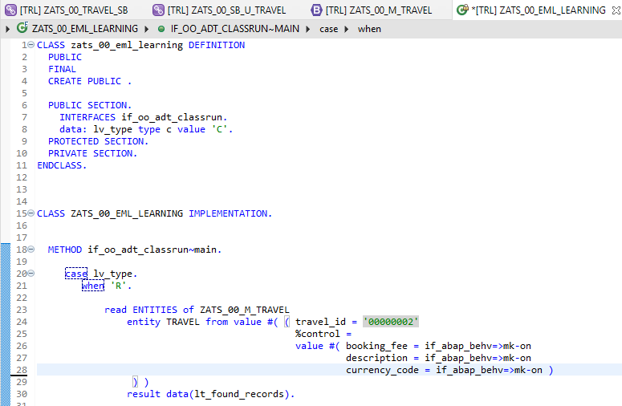
Implementing EML

Slide 30
Title
Text

Slide 31
Title
Text

Slide 32

Questions?

Slide 33

Thank you
Anubhav.abap@gmail.com
contact@anubhavtrainings.com
+91 84484 54549
www.anubhavtrainings.com

